Slide 1
Data
Number types
Date/Time types
Text type
True/false type
Binary type

Slide 2
How to extract data in Power BI?

Slide 3
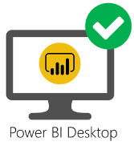
How to extract data in Power BI?
Data source

Slide 4

How to extract data in Power BI?
Data source
Connectors

Slide 5
How to extract data in Power BI?
Data source
Connectors
Software components that establish the connection between Power BI and the specific data source.

Slide 6

Excel workbook
Connector
Data source

Slide 7

Database
Connector
Data source

Slide 8

Text/CSV Connector
Data source

Slide 9
Connectivity Modes

Slide 10
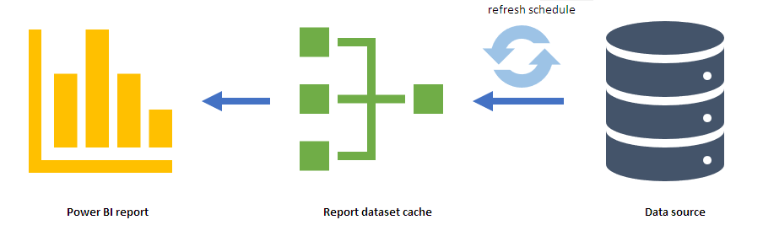
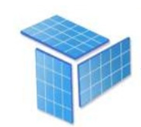
1. Import Mode
2. DirectQuery
Mode
Data Copy
3. Live Connection
Mode
Import is a method that gets a copy of data from the data source into Power BI
Refresh data to load data changes
Dataset Limit is 1 GB

Slide 11
1. Import Mode
2. DirectQuery
Mode
Data Copy
3. Live Connection
Mode
Import is a method that gets a copy of data from the data source into Power BI
Refresh data to load data changes
Dataset Limit is 1 GB

Slide 12
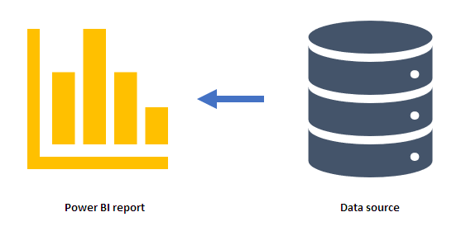
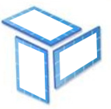
1. Import Mode
Schema
2. DirectQuery
Mode
DirectQuery is a method you can use to connect your semantic model to data
3. Live Connection
Mode
Use Cases:
You're working against data sources with a large volume of data
You want to use 'near real-time' data

Slide 13
1. Import Mode
Live connection is a way of connecting a Power BI report to a published Power BI dataset.
2. DirectQuery
Mode
Data sources:
A semantic model that already exists in Power BI service
An Azure Analysis Services (AAS) database
An on-premises instance of SQL Server Analysis Services (SSAS)
3. Live Connection
Mode

Slide 14
Loading Data From a Folder

Slide 16
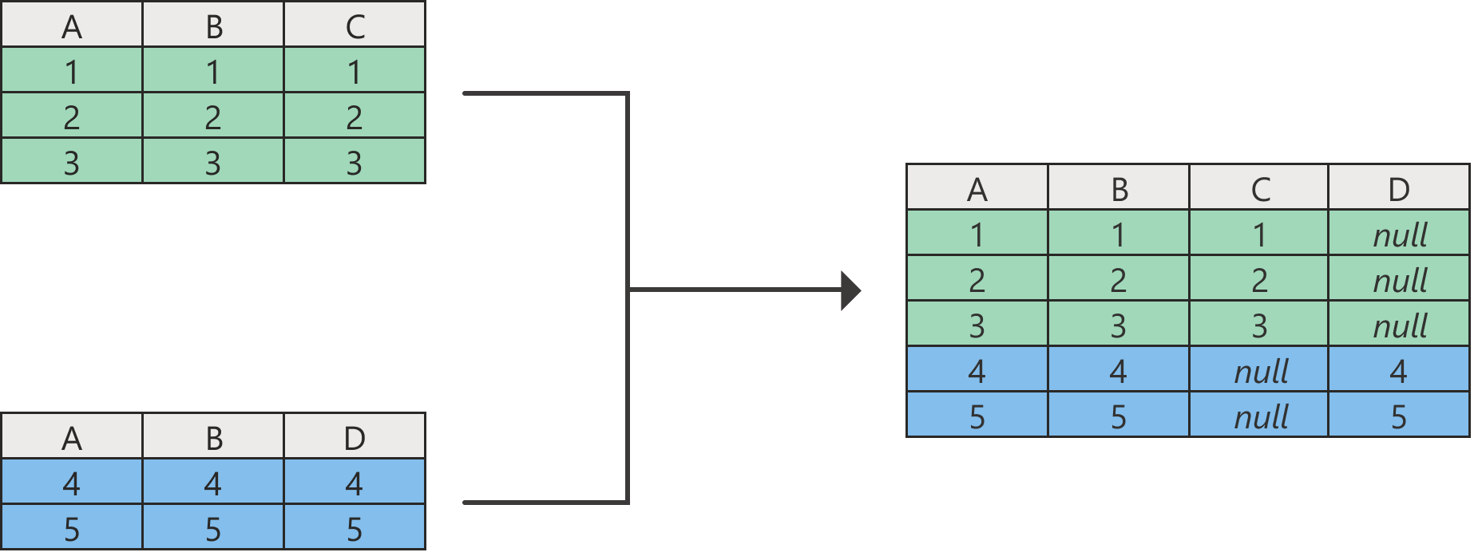
Append Queries

Slide 17
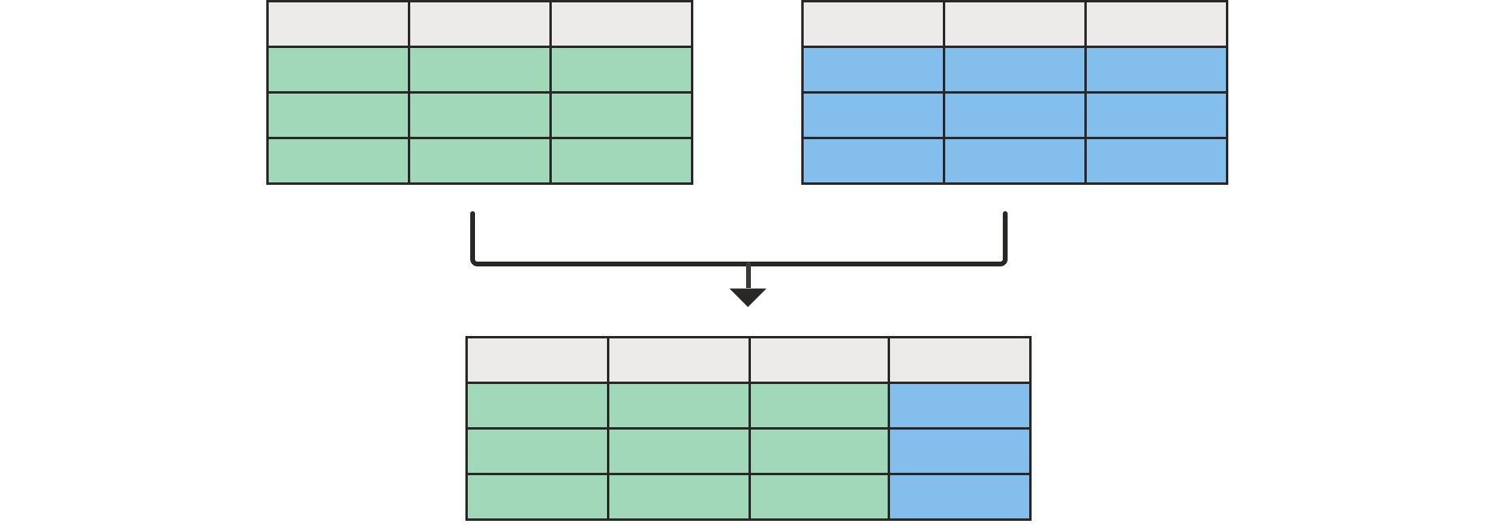
Merging Queries

Slide 18
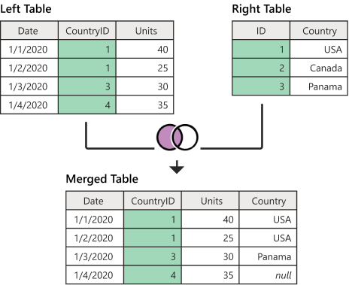
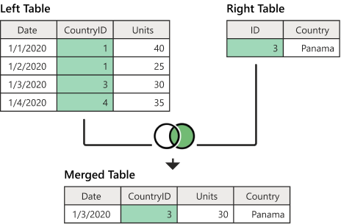
Left outer join
Right outer join

Slide 19
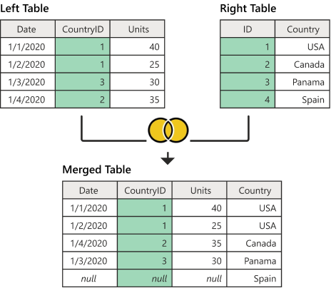
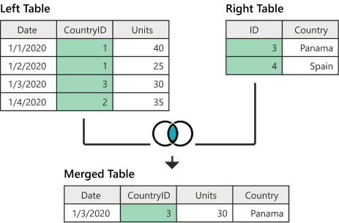
Full outer join
Inner join

Slide 20
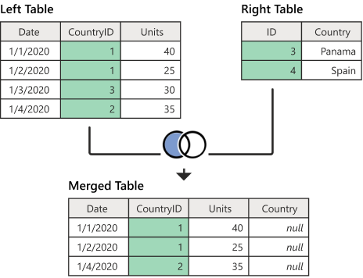
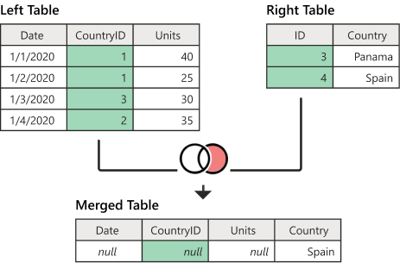
Left anti join
Right anti join

Slide 21
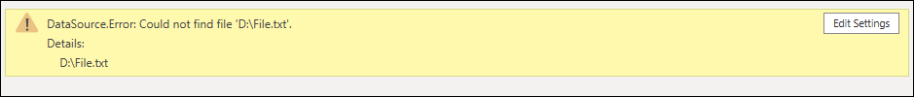
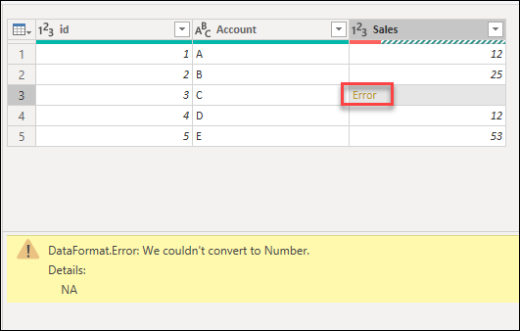
Errors in Power Query Editor

Slide 22
Errors in Power Query Editor
1
Step-level error
2
Cell-level error

Slide 23
Errors in Power Query Editor
1
Step-level error
Keep Errors
Rename Errors
Remove Errors
2
Cell-level error

Slide 24
Fact tables
Dimension tables /
Lookup Table
store observations or events
Examples:
sales orders,
stock balances,
exchange rates,
temperatures, etc.
describe business entities
Examples:
products,
people,
places, and
concepts including time itself..

Slide 25
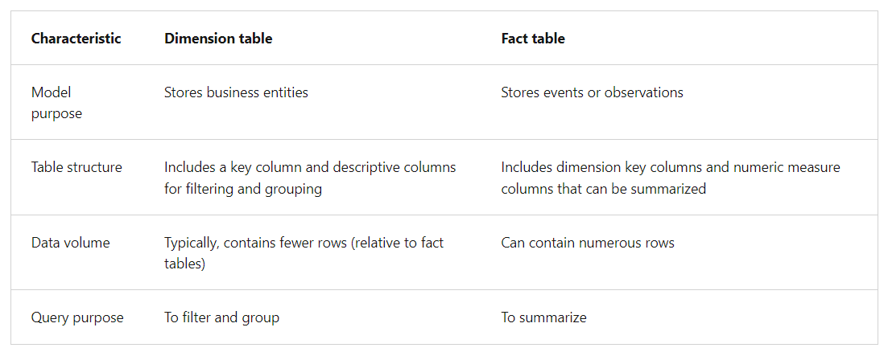

Slide 26
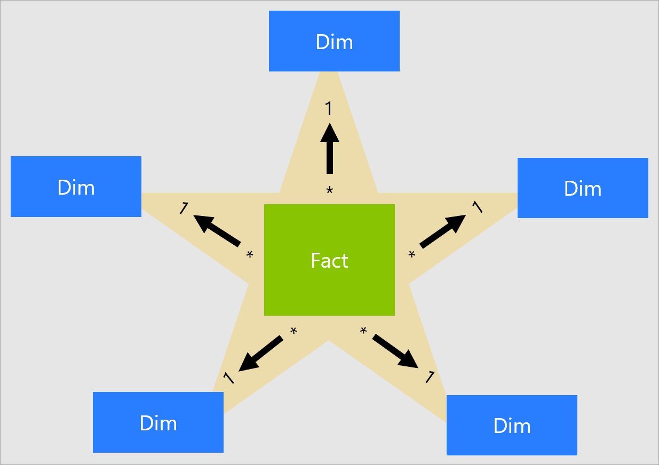
Star schema

Slide 27
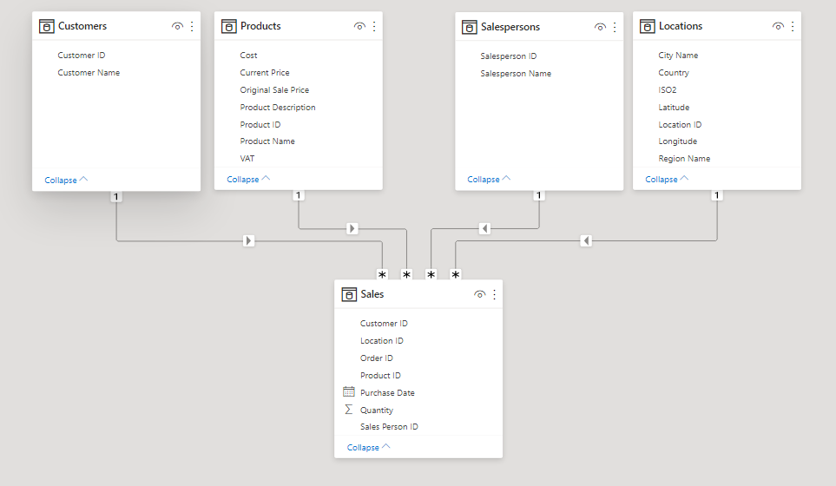
Star schema

Slide 28
Star schema

Slide 29
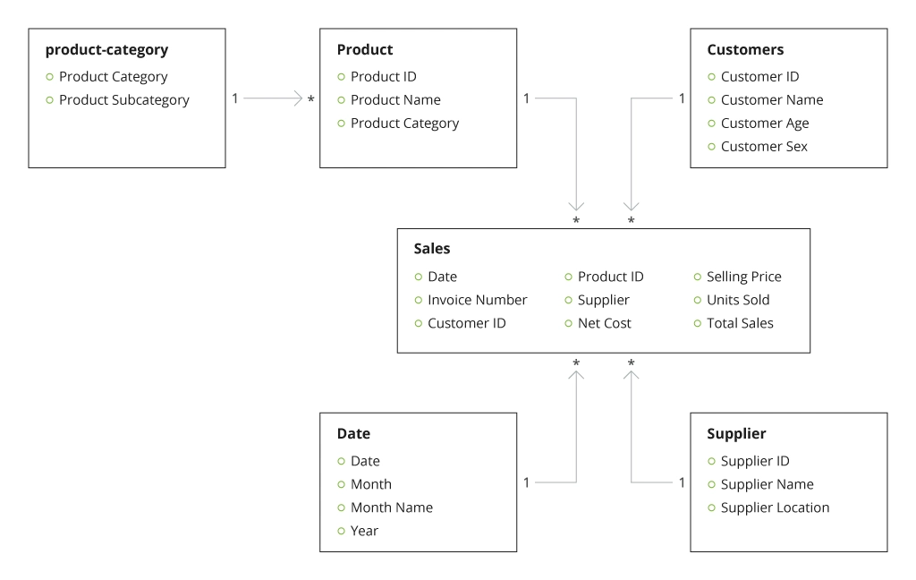
Snowflakes schema
Gender

Slide 30
Snowflakes schema
Gender

Slide 31
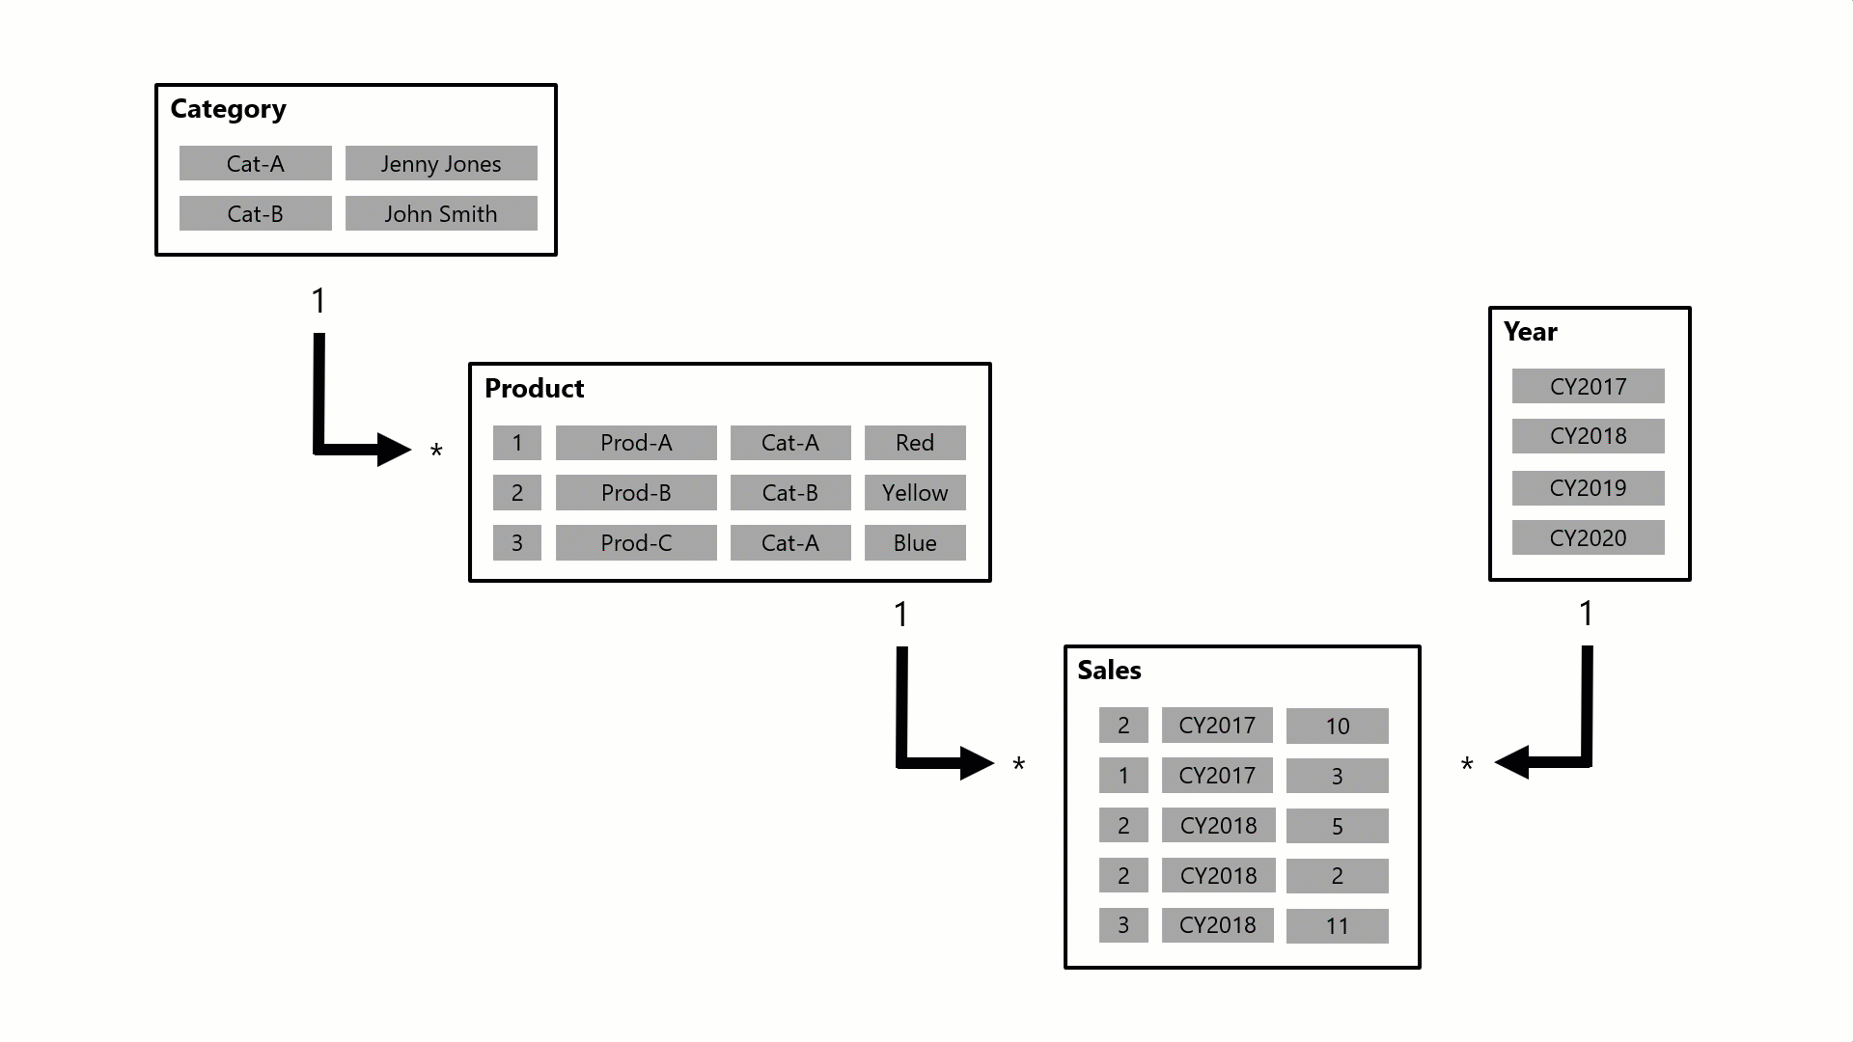

Slide 32
Exploring In-Depth Insights
In Power BI, there are several features and techniques to explore insights in-depth.
Some key approaches within Power BI:
Drill Down
Drill Through
Tool Tips
Navigating from summarized data to more detailed levels within the same visualization.
Moving to a dedicated page with detailed information specific to a data point in a report.
Displaying additional information upon hovering over a data point in a visualization, providing on-demand insights.

Slide 33
Exploring In-Depth Insights
In Power BI, there are several features and techniques to explore insights in-depth.
Some key approaches within Power BI:
Drill Down
Drill Through
Tool Tips
Navigating from summarized data to more detailed levels within the same visualization.
Moving to a dedicated page with detailed information specific to a data point in a report.
Displaying additional information upon hovering over a data point in a visualization, providing on-demand insights.

Slide 34
Exploring In-Depth Insights
In Power BI, there are several features and techniques to explore insights in-depth.
Some key approaches within Power BI:
Drill Down
Drill Through
Tool Tips
Navigating from summarized data to more detailed levels within the same visualization.
Moving to a dedicated page with detailed information specific to a data point in a report.
Displaying additional information upon hovering over a data point in a visualization, providing on-demand insights.

Slide 35
Exploring In-Depth Insights
In Power BI, there are several features and techniques to explore insights in-depth.
Some key approaches within Power BI:
Drill Down
Drill Through
Tool Tips
Navigating from summarized data to more detailed levels within the same visualization.
Moving to a dedicated page with detailed information specific to a data point in a report.
Displaying additional information upon hovering over a data point in a visualization, providing on-demand insights.

Slide 36
Visual Filtering
Visual Interaction
Slicers
Filters Plane
Interaction with one chart filters data in other charts to display only related information.
interactive buttons on the report page that, when used, filter and focus on specific data, allowing users to customize their view.
Tool that allows you to control the displayed information on individual visuals, entire pages, or the entire report

Slide 37
Visual Filtering
Visual Interaction
Slicers
Filters Plane
Interaction with one chart filters data in other charts to display only related information.
interactive buttons on the report page that, when used, filter and focus on specific data, allowing users to customize their view.
Tool that allows you to control the displayed information on individual visuals, entire pages, or the entire report

Slide 38
Visual Filtering
Visual Interaction
Slicers
Filters Plane
Interaction with one chart filters data in other charts to display only related information.
Interactive buttons on the report page that, when used, filter and focus on specific data, allowing users to customize their view.
Tool that allows you to control the displayed information on individual visuals, entire pages, or the entire report

Slide 39
Visual Filtering
Visual Interaction
Slicers
Filters Plane
Interaction with one chart filters data in other charts to display only related information.
interactive buttons on the report page that, when used, filter and focus on specific data, allowing users to customize their view.
Tool that allows you to control the displayed information on individual visuals, entire pages, or the entire report

Slide 40
Examples:
Top 5 Subcategories by Sales – Bar/column
Subcategories with total sales amount greater than 10L
Subcategories with total sales between 0.5L to 1L : sales >= 0.5L and sales <= 1L
Products from Subcategories – phones and copiers - table
Top selling product: card
Top 10 Customers by no. of orders placed: table
Subcategories in loss: bar

